Slide 1

Veteran and Military Affairs
Bama Bound
David Blair
Director

Slide 2

Follow us on Instagram!!!
@bamavma

Slide 3
AGENDA
Who We Serve
Office Location
Resources and Services
Scholarships
GI Bill Benefits and Processing Requirements
Alabama Dependent Scholarship
Alabama National Guard Education Assistance Program
Residency
Health Insurance
Parking
Contact Information

Slide 4
Who We Serve
Veteran- A student who is separated from military service (can be retirement, medical, or end of contract)
Service Member- On Active Duty
  National Guard/Reservist- Part Time
  Active Duty-Full Time
Dependent- A child or spouse of a veteran or service member
Survivor- A dependent who lost a guardian or spouse in the line of duty (FRY)

Slide 5

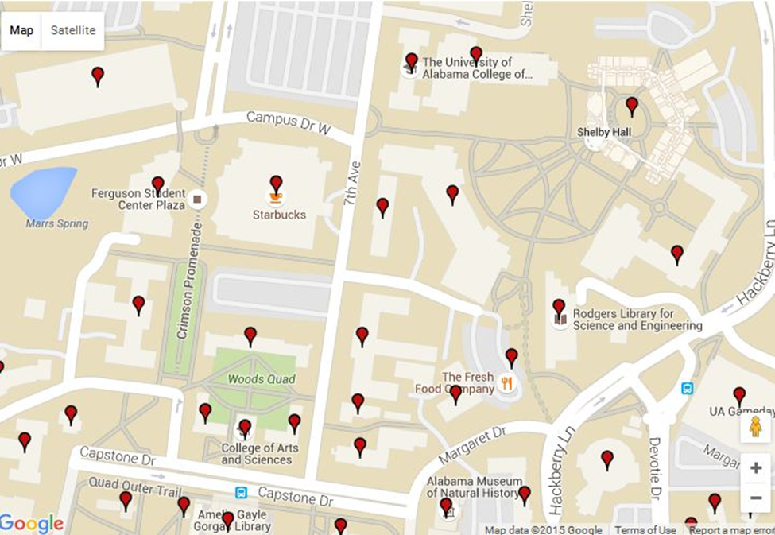
Office of Veteran and Military Affairs
Parking Deck
3000 Houser Hall
UA Student Center

Slide 6
Resources and Services
A computer lab- CAC readers
Free printing (please donate a ream of paper)
Lounge Space
Study Rooms
Stress Free Room
Conference Room/Interview Space
Break Room
On-Campus VA Health Clinic

Slide 7

On Campus VA Health Clinic
Phone: 205-348-2381
Fax: 205-348-3243
Email: vmahealthclinic@ua.edu
Address: 270 Kilgore Lane, Suite 1200, Box 870251 Tuscaloosa AL

Slide 8


Crimson Legion
All military-affiliated students welcome and encouraged to join! Veterans, Dependents, Guard/Reserves, Faculty & Staff
Parking: Off-campus students qualify for a reduced rate parking pass in our partnership lot with Alabama Marines Foundation - $180 for full school year
Game Day Tailgates: A free, safe environment to enjoy refreshments and watch the game
Volunteer Opportunities: Several committees to get involved: Veterans Advocacy, Dependent’s Advocacy, Community Outreach, Events & Fundraising
Social events: Bi-weekly coffee & small breakfast bites, BBQ’s and more!
Follow us on Instagram!

Slide 9
Military Affiliated Scholarships
Outside Scholarship List on Vets.ua.edu,
Resource Tab

Slide 10
No GI Bill Benefits?
Military affiliated students without GI Bill benefits have access to the resources and services offered at the VMA
The only documentation needed is your Student Information Form which is found on our main web page under the “Forms” tab

Slide 11
Know Your Benefits
Know Your Chapter Of Benefits (Chapter 33-Post 9/11 (FRY & Yellow Ribbon Scholarship), Chapter 35 Dependents Education Assistance, Chapter 30-Montgomery GI Bill, Chapter 31-Veteran Readiness and Employment, and Chapter 1606 Guard and Reserve GI Bill.
If you’re eligible for one of these benefits, you should have a Certificate of Eligibility (COE) issued by the Veterans Administration
In order to apply for one of these benefits you will need to go to va.gov or call the VA at 1-888-442-4551
Additional information can be found on our main web page under the “GI Bill” tab

Slide 12
Chapter 33
Pays tuition and fees
BAH: Approximately $1365 (prorated) per month
Book Stipend: $1000 divided between 2 semesters
Eligibility: Served at least 90 days on active duty (either all at once or with breaks in service) on or after September 11, 2001, or
Received a Purple Heart on or after September 11, 2001, and were honorably discharged after any amount of service, or
Served for at least 30 continuous days (all at once, without a break in service) on or after September 11, 2001, and were honorably discharged with a service-connected disability

Slide 13
Chapter 35
Monthly Stipend Only, Paid Directly to the Student: Approximately $1298 (prorated)
The account must have the student listed as an owner.
Eligibility: Dependent of 100% Totally Disabled Veteran
Typically 36 months of benefits to each dependent
You can only use one federal benefit at a time

Slide 14
Alabama National Guard Education Assistance Program (ANGEAP)
Eligibility (state benefit):
  Alabama National Guard member In Good Standing
  Completed Basic Training
Fill out an ANGEAP form every semester (under the “Forms” tab on our main page)
Must fill out FASFA every year and complete the FAFSA process
VMA Payment Plan is available for ANGEAP students
The State of Alabama pays at the end of each semester
Pell Grant and Academic Scholarships are Deducted from what the state pays
Additional detailed information can be found under the “GI Bill” tab on our main web page, vets.ua.edu

Slide 15
ANGEAP Documentation
In order to be certified for benefits from the State of Alabama we must have the following:
ANGEAP Form-complete with signature
Student Profile Form
Verification of FAFSA completion and submission
Required forms are found under the “Forms” tab on our main web page, vets.ua.edu

Slide 16
Federal Tuition Assistance
Students eligible for Tuition Assistance (TA)
  Active Duty, National Guard, Reservists
TA is not processed in our office but we do need to know if you’re receiving TA
For processing TA you will need to contact Mr. James Shamlee:
  All TA information can be found under the “Military TA” tab on our main web page, vets.ua.edu

Slide 17
James Shamlee Contact
Phone: 205-348-7646
Email: jshamlee@ua.edu

Slide 18
Alabama Dependent Scholarship
(known as the Alabama GI Bill)
Eligibility (state benefit):
  Veteran lives in Alabama (different residency requirements)
  40% Disability rating
10 semesters of benefits
Apply at local court house: va.alabama.gov
Get books from the Supply Store 1st week of school
As of July 2017
  “DOD Tuition Rate”
    $250 per credit hour
Processed by Student Account Services
Additional detailed information can be found under the “Resources” tab on our main web page, vets.ua.edu

Slide 19
Lisa Edwards Contact
Phone: 205-348-5350
Email: ledwards@ua.edu

Slide 20
Certification of Benefits
In order to be certified for benefits from the VA
WE MUST HAVE:
Certificate of Eligibility in the Students Name
Student Profile Sheet
Advising Worksheet-signed by the student and their advisor (physically or digitally)
These required forms can be found under Forms > VMA Forms on our website

Slide 21
VMA Forms Upload Link
Forms are submitted to the VMA office through the VMA Student Document Upload Link located on your student MY BAMA page under the Campus Life Tab.

Slide 22
Docusign
Students can fill out forms via Docusign by selecting them on our website in the VMA Forms section. After the student fills out their required info, they must enter their advisor’s email so they can also sign the form. The VMA will not receive the form until both the student and advisor have signed the document.

Slide 23
Payment Plans
All students eligible for Chapter 33/Post 9/11 or ANGEAP benefits should enroll in the VMA Payment Plan
  Once you’re registered for classes and have turned in all required documents to our office, the payment plan will be available on your MY BAMA student account. If you don’t see the VMA plan as an option, please notify our office.
All students using Chapter 30, Chapter 35, or Chapter 1606 will need to sign up for one of the University's other Payment Plans available through your MY BAMA student account.
Additional information on all Chapters of benefits can be found on vets.ua.edu under the “GI Bill” tab.

Slide 24
Incurring Debts
If students submit an Add/Drop form dropping a class after UA’s add/drop date YOU WILL INCUR A DEBT
UA will pay the VA’s debt on behalf of the student, and then charge the student’s student bill
Students can also incur a debt for NC Grades

Slide 25
Alabama Dependent Scholarship Documentation
The Office of Veteran and Military Affairs does not process this benefit, but we do need your “Student Profile Form” to find you eligible for additional benefits and for you to have student access to the VMA.

Slide 26
Chapter 35 Residency
Colonel John M. McHugh Tuition Fairness for Survivors Act of 2021 (SB 1095)
This law requires that the Department of Veterans Affairs (VA) disapprove courses at institutions of higher learning that charge a higher rate of tuition and fees than those in-state rates for individuals using the Survivors’ and Dependents Educational Assistance program.
Many colleges and universities have adopted policies granting active service members in-state tuition rates while stationed in various states. This law ensures that those survivors and dependents receiving educational assistance will receive the same benefit.
However, instead of waiting for each state to pass its own version of the law, this legislation directs the VA to disapprove courses at approved institutions who are still charging out-of-state

Slide 27
All Other Residency
If you are a veteran, service member or dependent you may be eligible for the in-state tuition rate. The VMA office does not make determinations on residency classifications.
If you have questions concerning residency or believe that you are eligible for in-state residency reclassification, you must email residency@ua.edu or call 205-348-2020. You will find a link to the application at registrar.ua.edu.

Slide 28
Residency cont.
Reclassifying may impact your UA scholarships If you have questions concerning scholarships, please reach out to the scholarship office at scholarships@ua.edu or call 205-348-8201.
We do not have any say in residency applications or scholarship changes

Slide 29
Monthly Enrollment Verification
The VA has implemented a monthly enrollment verification for post 9/11 students
To enroll, call the Education Call Center (1-888-442-4551) to update your contact information (phone number and/or email address)
Updating contact info on your va.gov profile does NOT update your info for educational benefits. You must call the Educational Hotline to update info.

Slide 30
Work Study Opportunity
Both the VMA Office and VA Clinic have opportunities for Students to work during the school year
Must be full time student on federal benefits
$7.25 per hr. (tax free)
Flexible Hours
Minimum 10 hrs. max. 25
Interviews are ongoing now!

Slide 31
Health Insurance
For proof of enrollment you can print an “enrollment certificate” for health insurance AFTER your student registers for classes.
Additional details can be found under the “FAQ” tab on our main web page

Slide 32
Parking
Military Affiliated Students have an additional option for purchasing a parking pass. In you are interested in parking near the Clara Verner Towers and catching a bus to class you can purchase a parking pass from the Campus Veterans Association at a reduced cost.
You can explore this option by sending an email to ua.veteran.parking@gmail.com

Slide 33
CONTACT
Office of Veteran and Military Affairs
3000 Houser Hall
205-348-0983
Email - vma@bama.ua.edu
Website - https://vets.sa.ua.edu/

